Slide 1
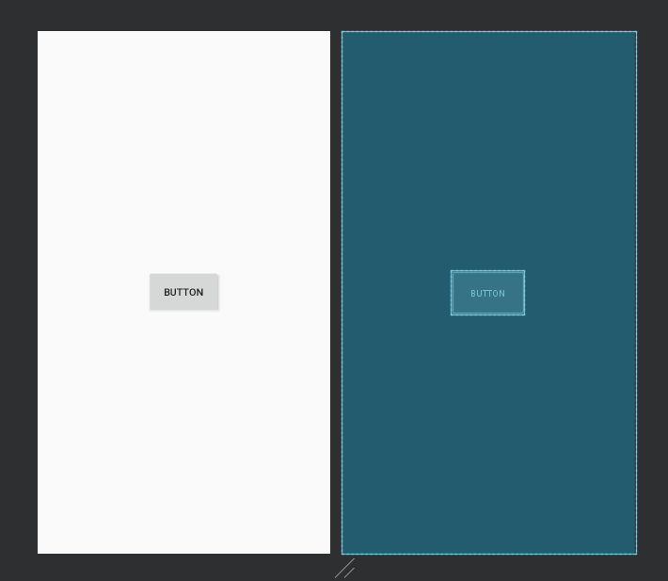
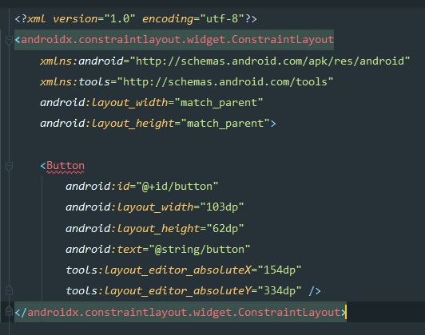
위젯 (Widget)
뷰 (View)

Slide 2
